Slide 1
Types of Rainfall
7 HASS

Slide 2
Rain
The three most common types of rain fall all occur as hot air rises.
As hot air rises it cools and can therefore not hold as much moisture.
It is at this point that condensation occurs where the water vapour (gas) is turned back into a liquid

Slide 3
Convectional Rainfall - tropics
The surface of the earth is heated by the sun.
The warm surface heats the air above it. Hot air always rises so this newly heated air does so.
As it rises the air-cools and begins to condensate.
Further rising and cooling causes a large amount of condensation to occur and rain is formed.

Slide 4
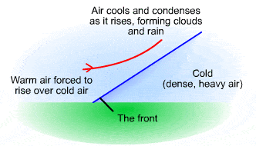
Frontal Rainfall -most common
Two air masses meet, one a warm air mass and one a cold air mass.
The lighter, less dense, warm air is forced to rise over the denser, cold air.
This causes the warm air to cool and begin to condense.
As the warm air is forced to rise further condensation occurs and rain is formed.
Frontal rain produces a variety of clouds, which bring moderate to heavy rainfall.

Slide 5
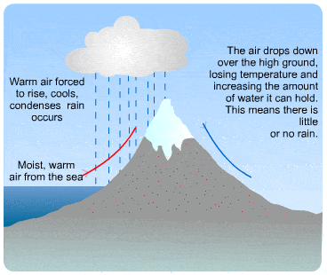
Orographic Rainfall -mountain ranges
The prevailing winds pick up moisture from the sea as they travel across it, making the air moist.
The moist air reaches the coast and is forced to rise over mountains and hills.
This forces the air to cool and condense, forming clouds.
The air continues to be forced over the mountains and so it drops its moisture as relief rain.
Once over the top of the mountain the air will usually drop down the other side, warming as it does so. This means it has a greater ability to carry water moisture and so there is little rain on the far side of the mountain. This area is called the rain shadow.

Slide 6
https://www.youtube.com/watch?v=i36U3LpJjzU&t=71s

Slide 7
Textbook
Pages

Slide 8
Types of Precipitation
Foldable activity - homework

